Slide 1
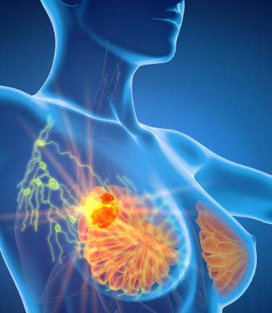
BREAST CANCER PREDICTION
2023

Slide 2

Meet our TEAM
WEI CHEN
FRANCIS RIVERA
CHANDRANI GHOSH
SIMPEL OSMAN

Slide 3
AGENDA
Breast Cancer Analysis & Diagnosis
Cancer Rates Analysis
Introduction
Summary
Machine Learning Models

Slide 4
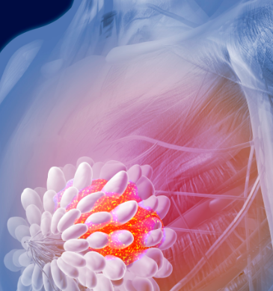
Introduction
Breast cancer is a type of cancer that starts in the breast. It can start in one or both breasts. Cancer starts when cells begin to grow out of control and occurs almost entirely in women, but men can get breast cancer too.

Slide 5
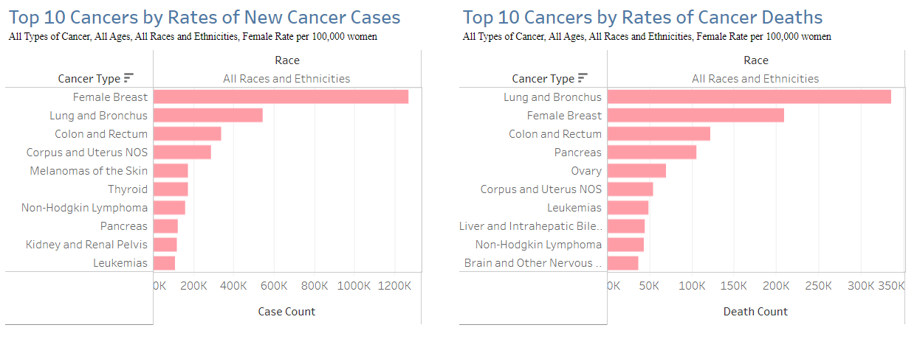

Slide 6
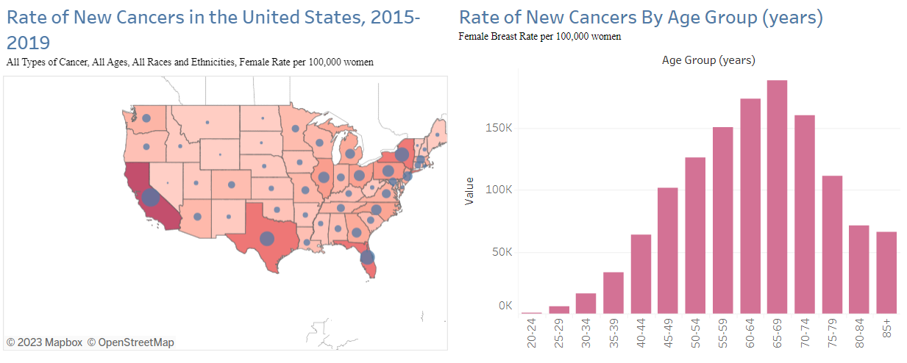

Slide 7
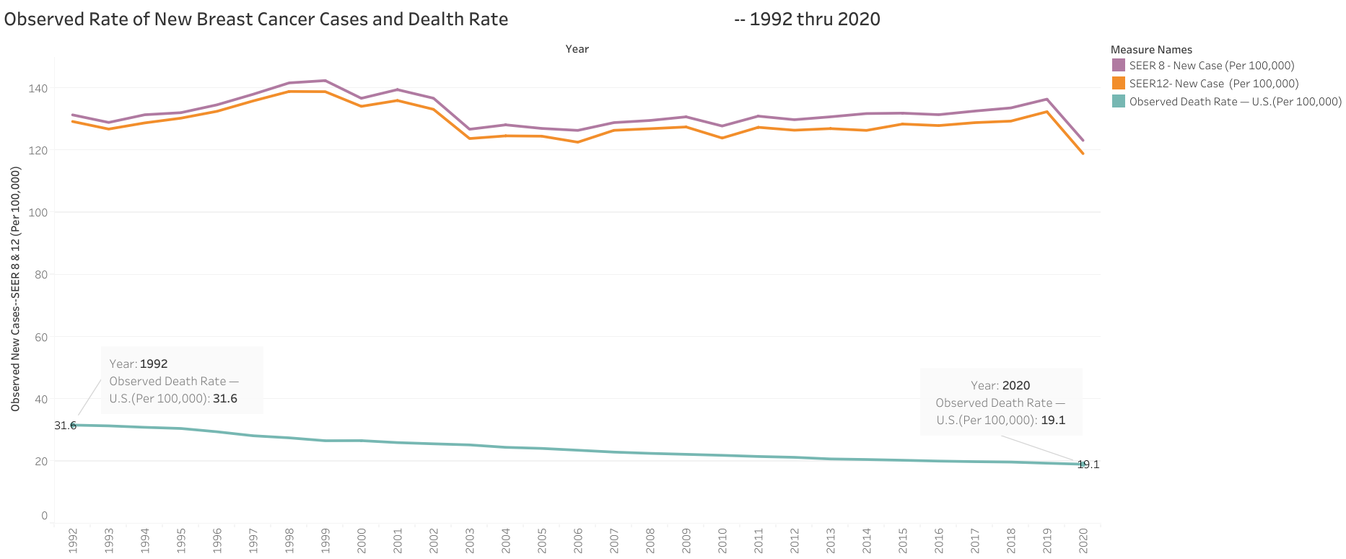

Slide 8
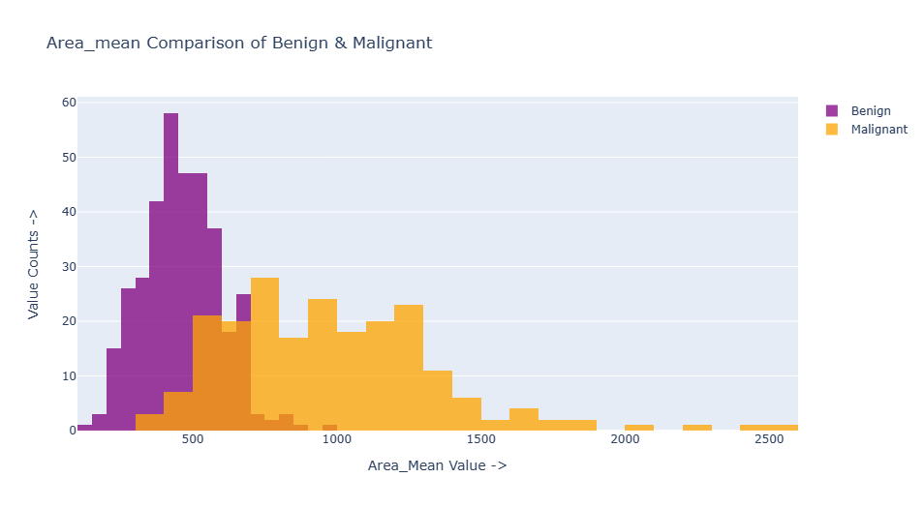

Slide 9
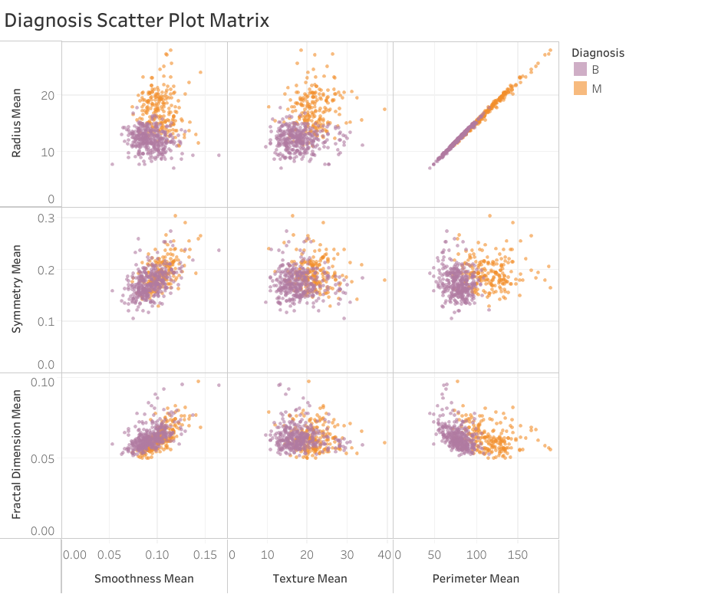

Slide 10
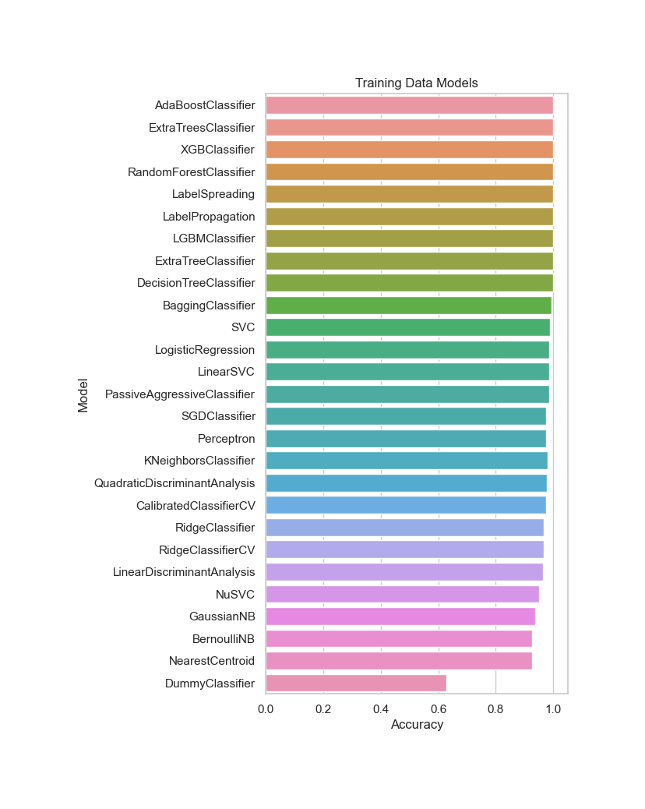
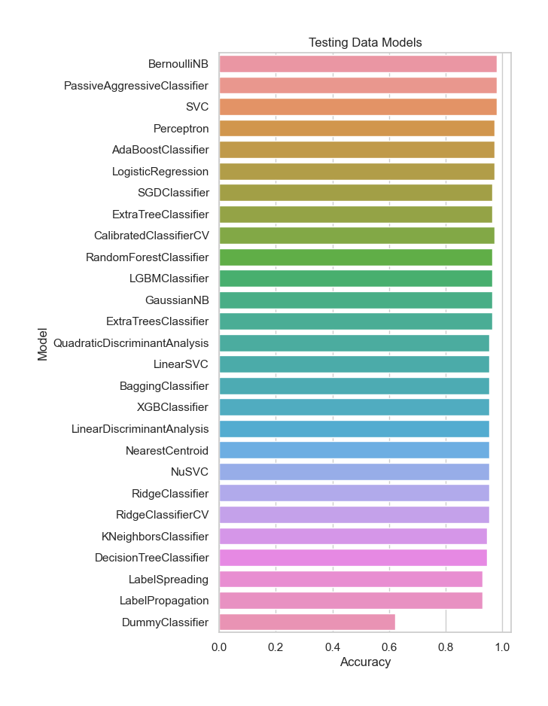
Comparing Classifier Models
Comparing Classifier Models

Slide 11
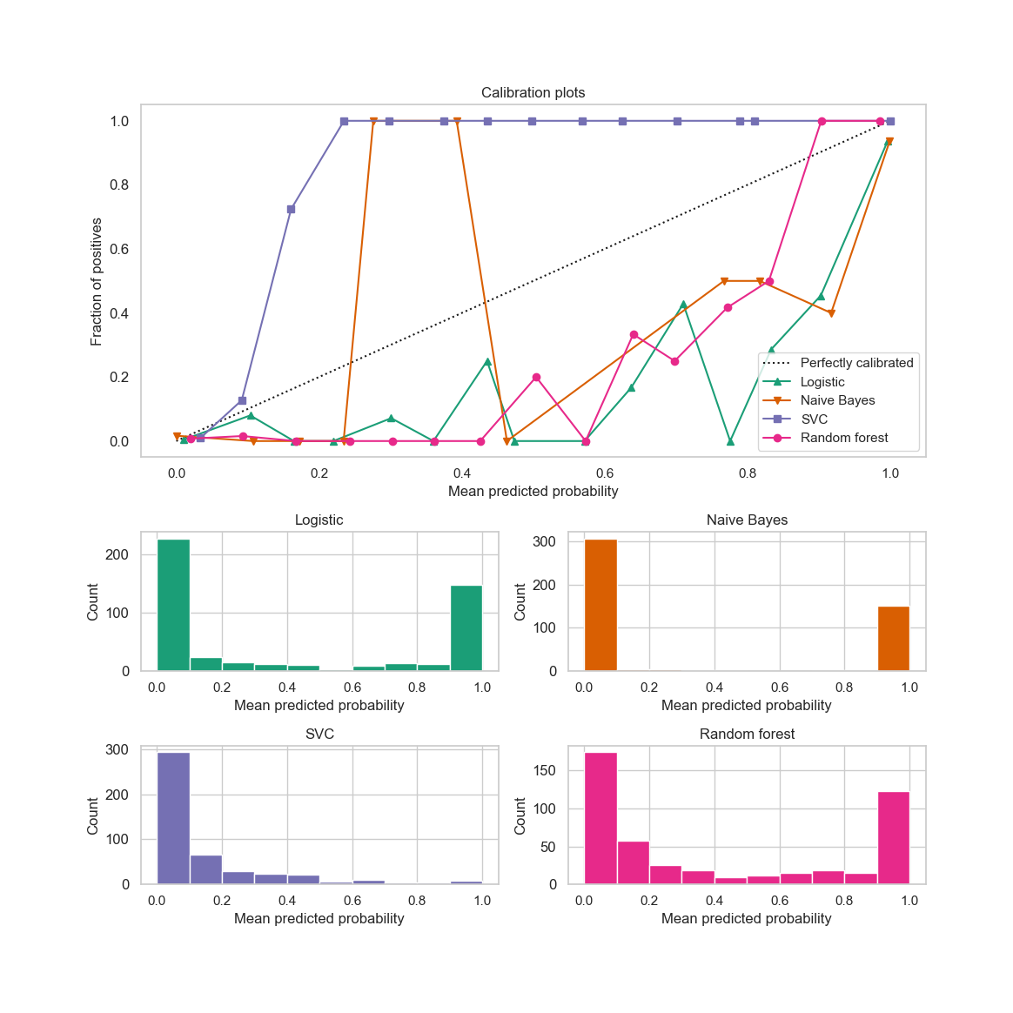
Calibration Plots

Slide 12
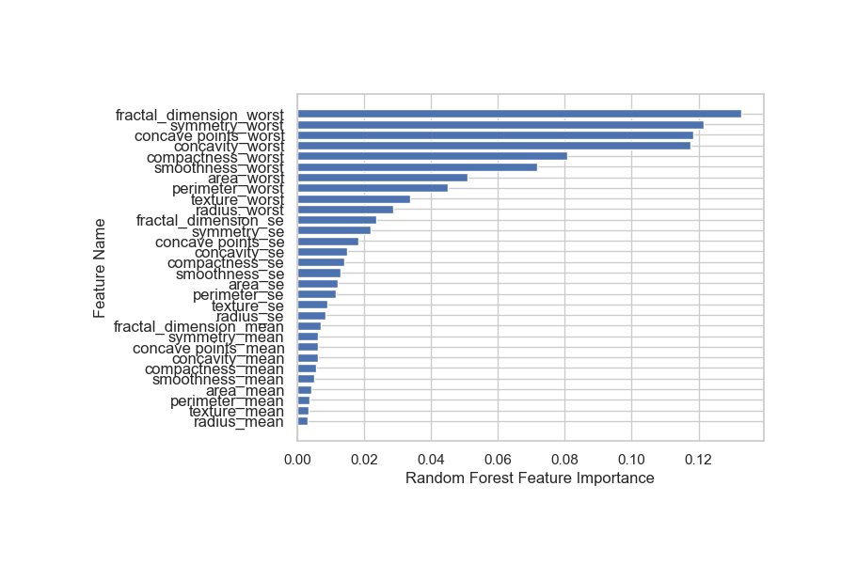
Random Forest
Feature Importance
Accuracy: 96.5%

Slide 13

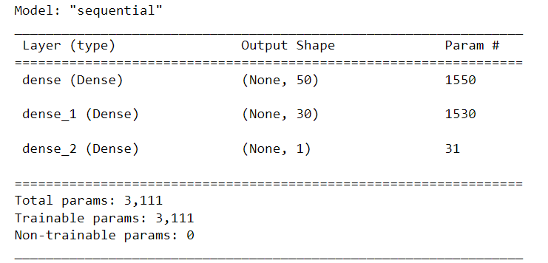
Neural Network
ADA Boost Classifier
Accuracy = 97.3%
Accuracy = 96.5%

Slide 14

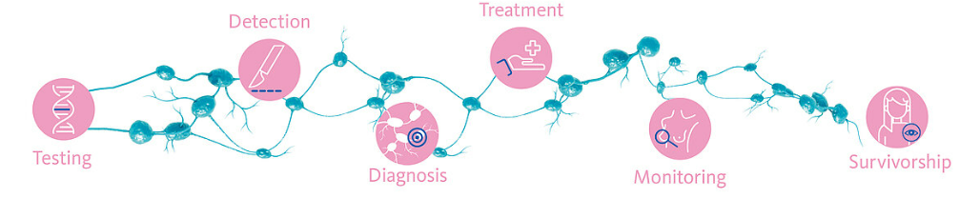
Summary
Future work can be applying different machine learning approaches, accessibility to bigger datasets from different institutions (multi-center study), and considering key features from a variety of relevant data sources.
Different ML like Apache Hadoop, for bigger data. Also, in the future we can find data solutions. For example; setting expectations, finding and collecting more information, then revising expectations.
https://simpelaki.github.io/final_project/#contact

